Slide 1
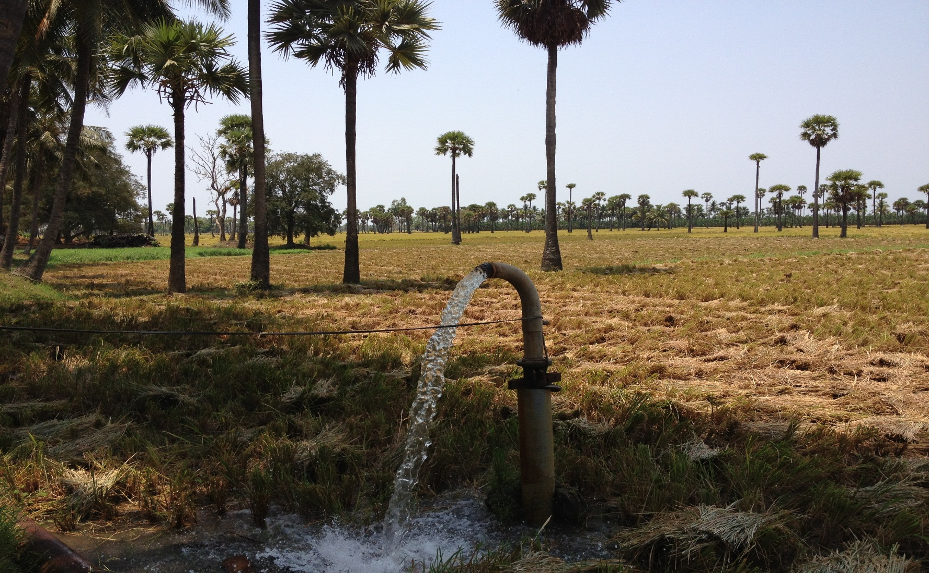
hidden treasure: Groundwater in india
World Bank
Global Water Practice (GW Team):
Param Iyer, Bill Young, Anju Gaur, Hanan Jacoby, Rafik Hirji, Richard Damania

Slide 2
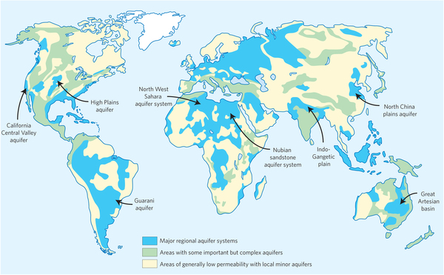
India is the world’s largest user of groundwater for agriculture
South Asia accounts for 48% of global GW use for irrigation
Source: Siebert et al. (2010)
% of grid-cell equipped for GW irrigation

Slide 3
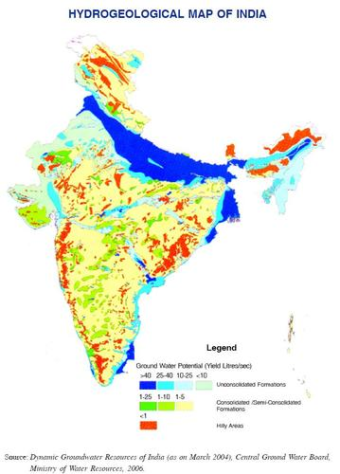
But, Within india, contexts differ
Punjab:
Deep alluvial aquifer
Andhra Pradesh/Telangana :
Shallow hard-rock aquifer
Notes:
Shallow ➔ annual recharge can be extracted and not much more; i.e., not mining fossil GW

Slide 4
Transformational impact: agricultural intensification
GW Share in irrigation increasing
Allows for more cropping

Slide 5
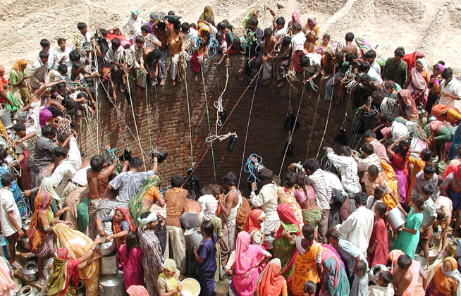
end of the dugwell era………
Based on 62 villages in 2007 AP
Mean number of (millions) | 2007 | 2012
Functioning dugwells | 16.1 | 4.2
Non-functioning dugwells | 9.9 | 20.9
In the mid 2000’s, there were more than 9 ml. open dugwells with mechanized pumps.
About a million alone in AP.

Slide 6
Declining water table & poverty in UP
At 8m depth a submersible pump is needed
So at 8m access to GW more costly
Poverty headcount jumps at the 8m mark
Village poverty rate rises by 11 % just above 8 meter WT threshold
Source: Sekhri (2014)

Slide 7
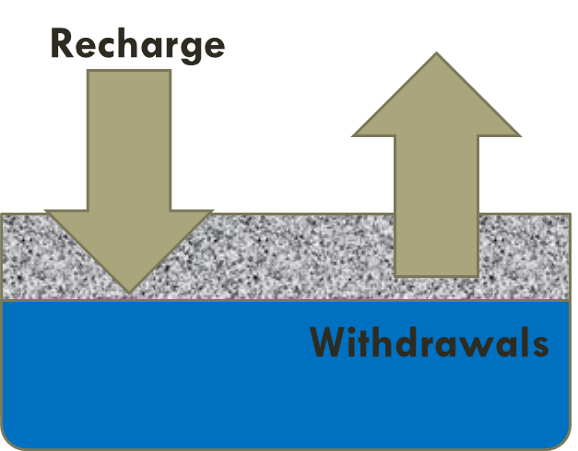
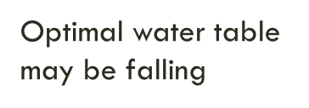
Why problems? Economics of the well
Shared (common pool) + renewable resource (sustainable)
Pump too much from each well
Too many wells drilled
(But sometimes “optimal” to “overpump” (mine)
When future rewards from use lower than present payoffs)

Slide 8
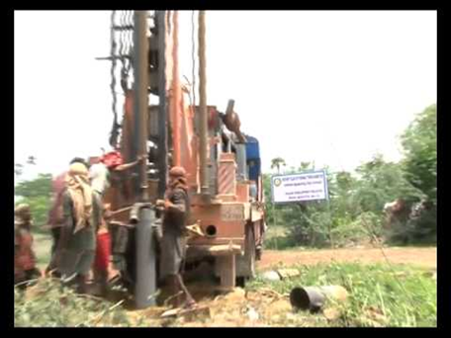
Economics of the well
Message 2. Information problems:
What is not known, cannot be managed
→ need to measure aquifer level and well (household) level
Message 3. Water quality – degrade the asset irreversibly

Slide 9
Implications of Free energy – evidence from AP survey
Average return (present value) to well = Rs 31.4k
“Free” energy value (cost in present value) = Rs 56.6k
Loss = 31.4 – 56.6 = - Rs 22.5k
Conclusion: without subsidy marginal well is NOT PROFITABLE
→ have fewer wells and less pumping from each well

Slide 10
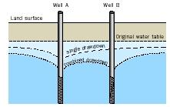
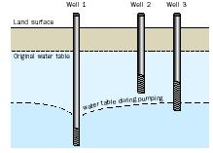
Too much drilling →Well clustering → cone of depression
total discharge $≪$ twice individual discharge
Deeper is better
Notes:
Cone of depression. Greater drawdown➔ lower yield

Slide 11
Drilling deeper
AP sample survey of 2400 borewells in 144 villages.
Recently sunk borewells deeper. Trend is accelerating…
Deeper wells more costly
Wells much deeper over time

Slide 12
And Older wells failing

Slide 13
Copy cat effects: Borewell Clustering
“Copy cat”- the more everyone drills, the more I drill!

Slide 14
Clustering reduces borewell yield
Greater clustering reduces well discharge.
Example of wasteful competition for groundwater.
Borewells within 100 meter radius of 369 randomly chosen borewells in AP.

Slide 15
Vicious cycle
As water table falls → pump longer and drill more → more well clustering →
lower discharge rates (yields) → greater probability of failure
Consequences:
Energy cost;
farm losses;
depleting nation’s natural capital
Lose- lose-lose

Slide 16
From vicious to virtuous cycle
Need to tackle incentives to over-drill and over-pump
No one-size fits all: Punjab aquifer different from AP aquifers
No silver bullet either!

Slide 17
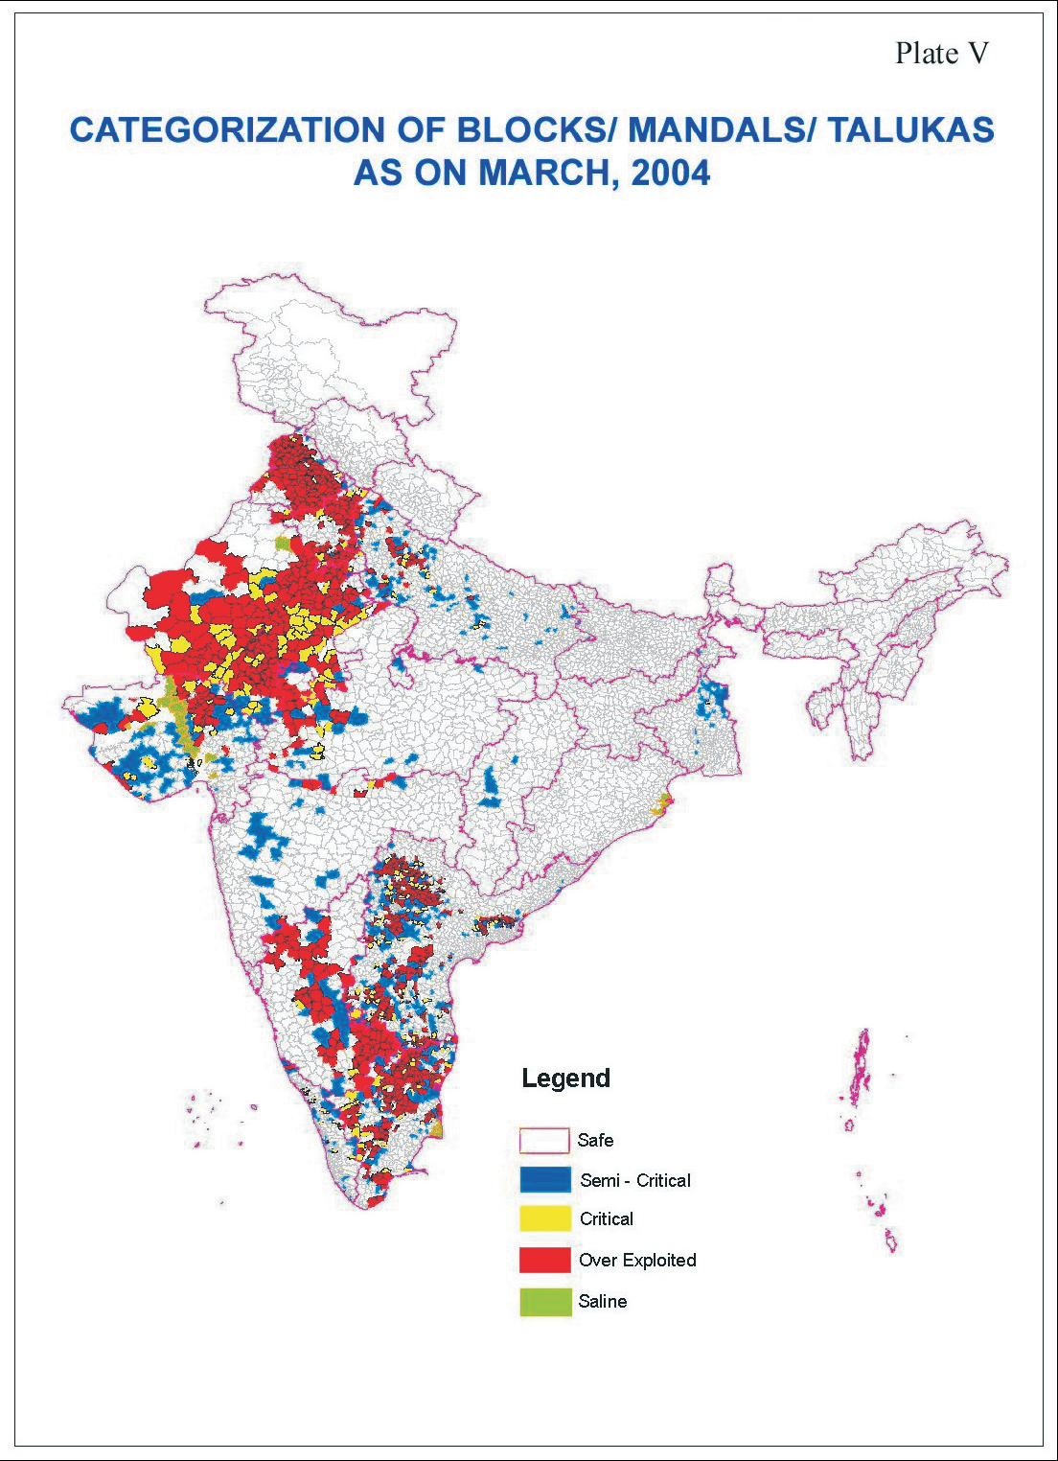
Challenge is to implement site specific
interventions and policies
Depleting Water Table
Low water usage, energy, water quality interaction
Inefficient Groundwater irrigation systems
Rising water table in surface irrigated areas

Slide 18
Some ideas going forward
Investments in recharge
Does not solve over-drilling problem
Metering – can’t control what is not known
Community groundwater management (piloted in AP)
Provides information on local aquifer to inform dry season planting decisions.
Needs to be rigorously evaluated and subjected to cost-benefit analysis.

Slide 19
Bolder Collective action solutions
Groundwater Users Associations
Meter each well
Allow community to determine allocation: a % of available GW (right/ claim)
Total available supply for distribution
Association ensures new drilling within legal limit (say 300m in AP)
Association monitors breaches
Success ultimately depends on legal enforcement
Not feasible everywhere!!
No one-size-fits-all

Slide 20
Other options if measure usage:
Charging for water
Block pricing structure
First X gallons is free, then charge
Recognize user resistance to pricing
The Brazilian solution:
Subsidy (grant) for using less than amount X
Could be combined with “charge” for using more than X

Slide 21
General Policies
Price subsidies for groundwater-intensive crops (rice, sugarcane, wheat)
Meter electricity and charge per kwh
This will ultimately be irrelevant if farmers convert to solar-powered pumpsets
Do not subsidize solar-powered pumpsets!
Water quality
Drip irrigation: May not be a panacea against depletion
Farmers will intensify production or sell water to neighbors without borewells
Net effect on groundwater pumping is uncertain

Slide 22
thank you!

Slide 23
annex

Slide 24
India’s borewell revolution
 |  | No. of borewells (millions) By motive power of pump
State | Census year | electric | diesel | total
Punjab | 1995 | 0.82 | 0.67 | 1.49
 | 2010 | 1.17 | 0.27 | 1.44
AP | 1995 | 0.50 | 0.02 | 0.52
 | 2010 | 1.54 | 0.02 | 1.56
Switch from centrifugal to submersible pumps in Punjab
Switch from no borewell to submersible pump in AP
Notes:
Borewell revolution started earlier in Punj. IN

Slide 25
Energy costs and returns to drilling in ap
Private returns (PV terms) when electricity is supplied free: Rs 34.1k
What if electricity to run pump is priced at cost rather than free?
(Assume: Pump uses 4.7 kwh per hour, operates 900 hours per year, cost of electricity = 0.75 Rs./kwh)
➔ Capitalized power subsidy = 56.6k Rs.
➔ Net private return = 34.1 – 56.6 = Rs -22.5k
Conclusion: Without power subsidy, marginal borewell not economically viable
➔ pump more and drill more

Slide 26
Energy costs and returns to drilling in ap
Well ownership in two drought-prone districts of AP estimated from sample survey data
Gross private return (in present value terms) Rs 79.8 thousand
Cost of a borewell when success is uncertain
Installation cost (drilling, casing, connection) = Rs 23k
Cost of failed attempt (drilling) = Rs11.5k
Expected cost (taking into account average probability of failure) = Rs 45.7k
Net private return = 79.8 – 45.7 = Rs 34.1k

Slide 27
Cost of electricity subsidy
What if electricity to run pump is priced at cost rather than free?
Assume:
Pump uses 4.7 kwh per hour of operation
Operates 900 hours per year
Cost of electricity = 0.75 Rs./kwh (off-peak ag. power tariff in W. Bengal)
➔ Capitalized power subsidy = 56.6k Rs.
➔ Net private return = 34.1 – 56.6 = -22.5k Rs.!
Conclusion: Without the heavy power subsidy, the marginal borewell would not be economically viable
➔ subsidy results in wells that would not otherwise have been drilled (and by farmers who can least afford to drill them).
Notes:
To appease agricultural constituencies, electricity in AP, as in many states, has over time become free of charge.

